Slide 1
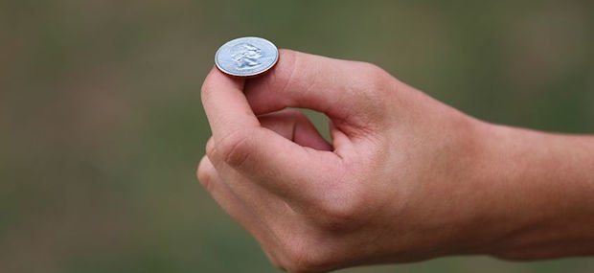
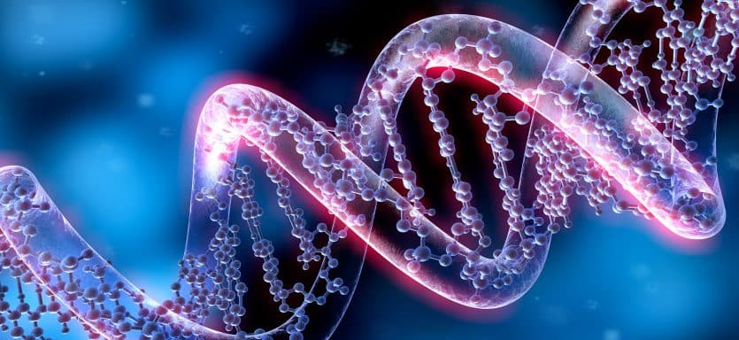
From Coin Tossing to the Code of Life
Deciphering Population Genetics
Wanjun Gu
May 6th, 2024

Slide 2
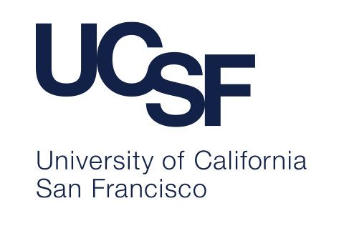
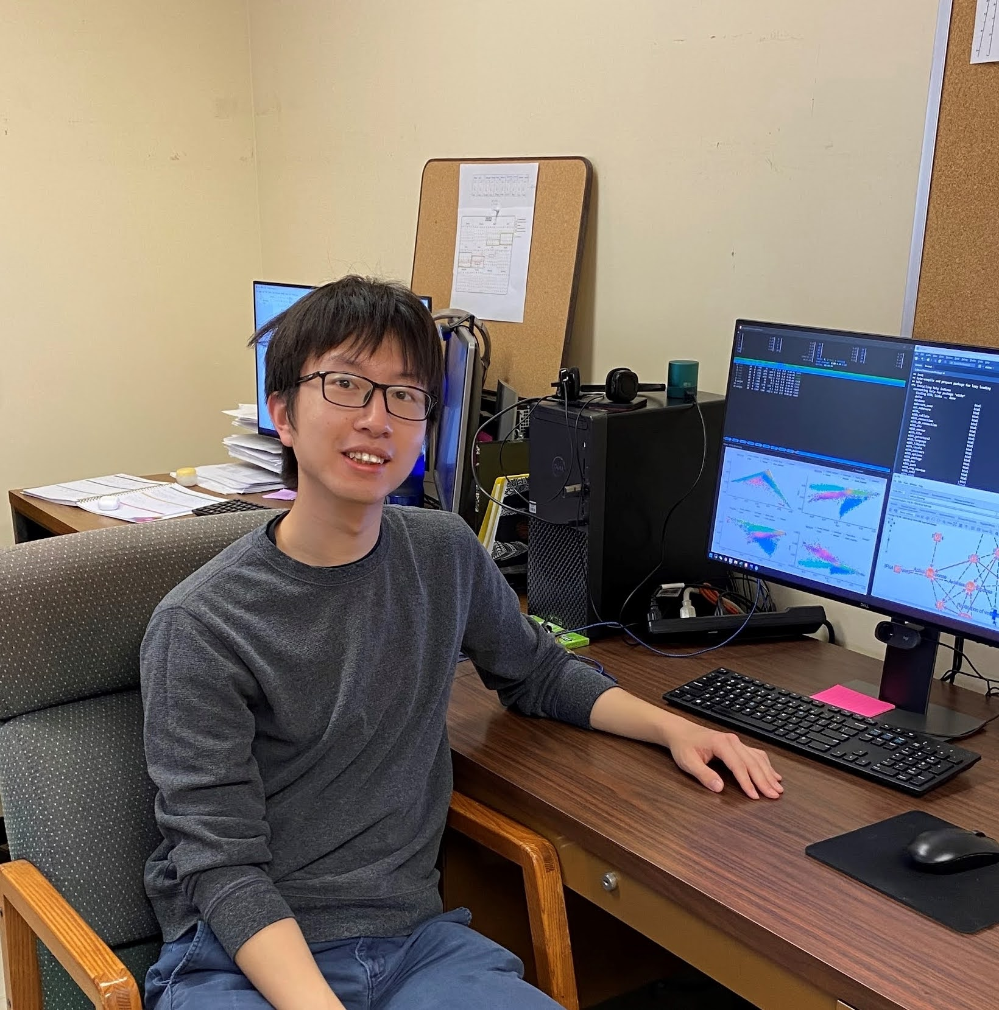

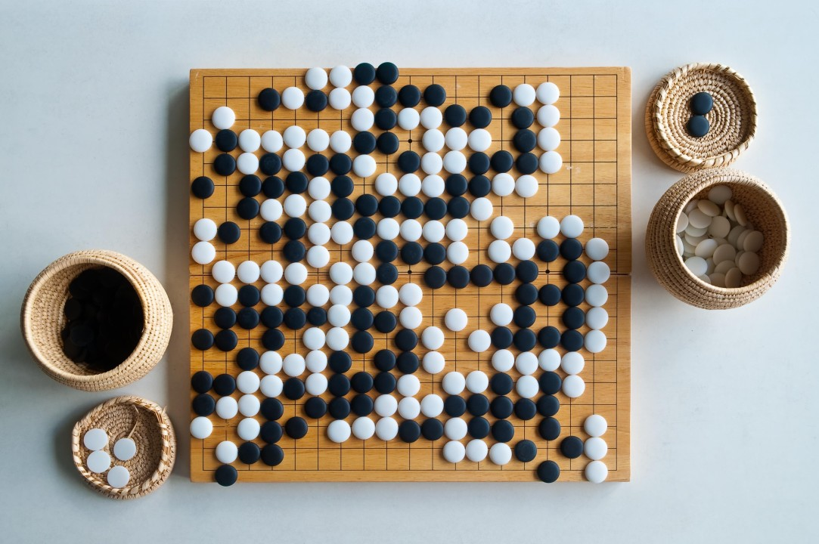
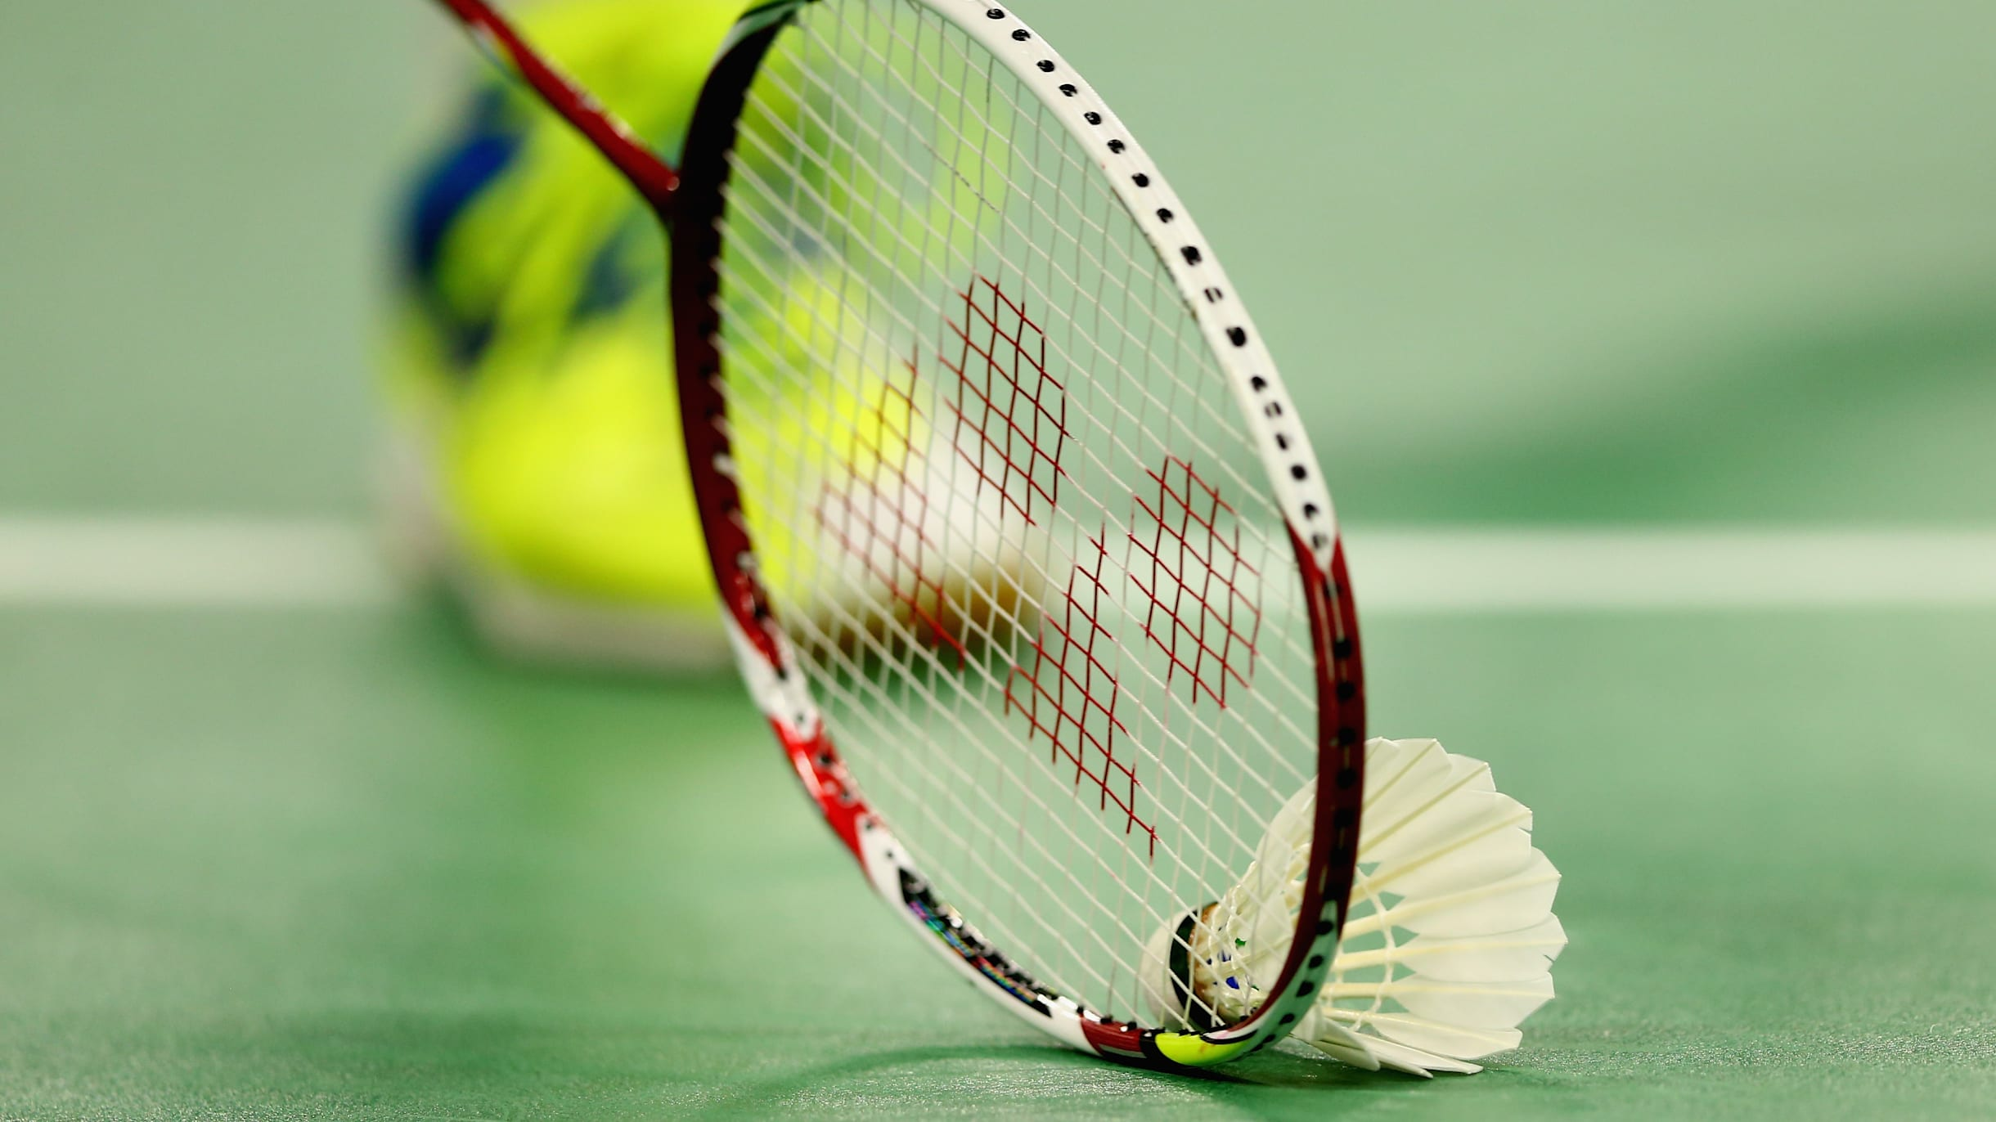
About me
I am a PhD Candidate at the University of California, San Francisco (UCSF)
I am a researcher in Genetics, and Bioinformatics (computer science, data, and biology)
I was born and raised in Qingdao, China
I like badminton and go

Slide 3

Coin tossing experiment
Toss a fair coin 10 times
Count the number of times that the coin lands on head
How likely it is that the coin lands more than 6 times on head, or less than 4 times on head?
What is the most likely outcome?

Slide 4

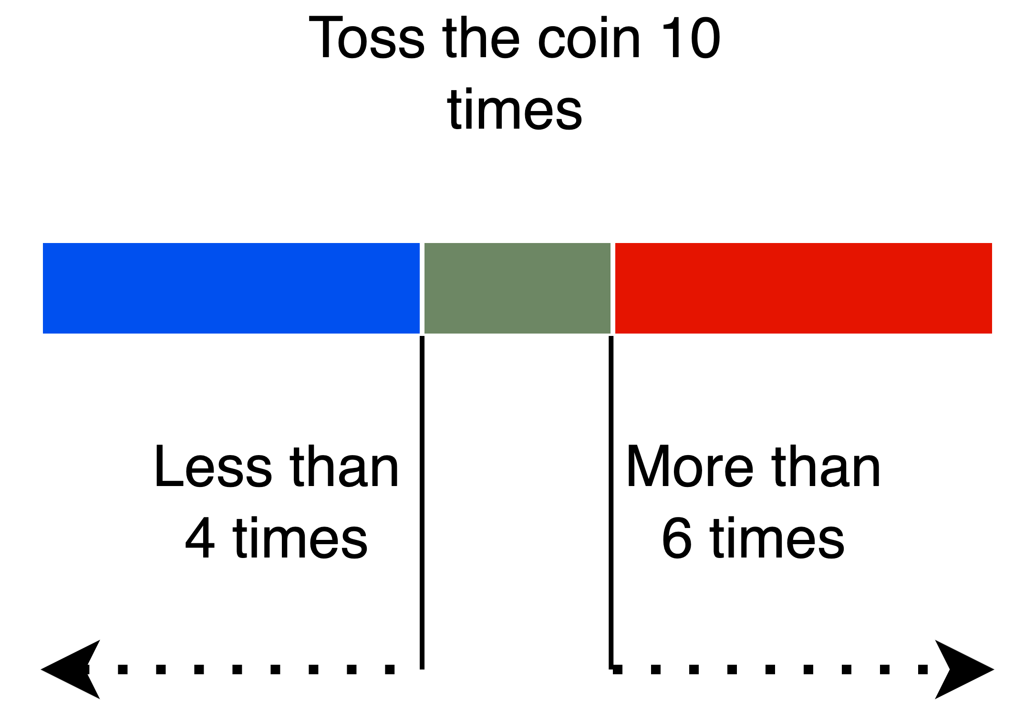
Coin tossing experiment
Toss a fair coin 10 times
Count the number of times that the coin lands on head
How likely it is that the coin lands more than 6 times on head, or less than 4 times on head?
What is the most likely outcome?

Slide 5
Coin tossing experiment
Toss a fair coin 10 times
Count the number of times that the coin lands on head
How likely it is that the coin lands more than 6 times on head, or less than 4 times on head?
(34.4%)
What is the most likely outcome?
(5 times on head)

Slide 6
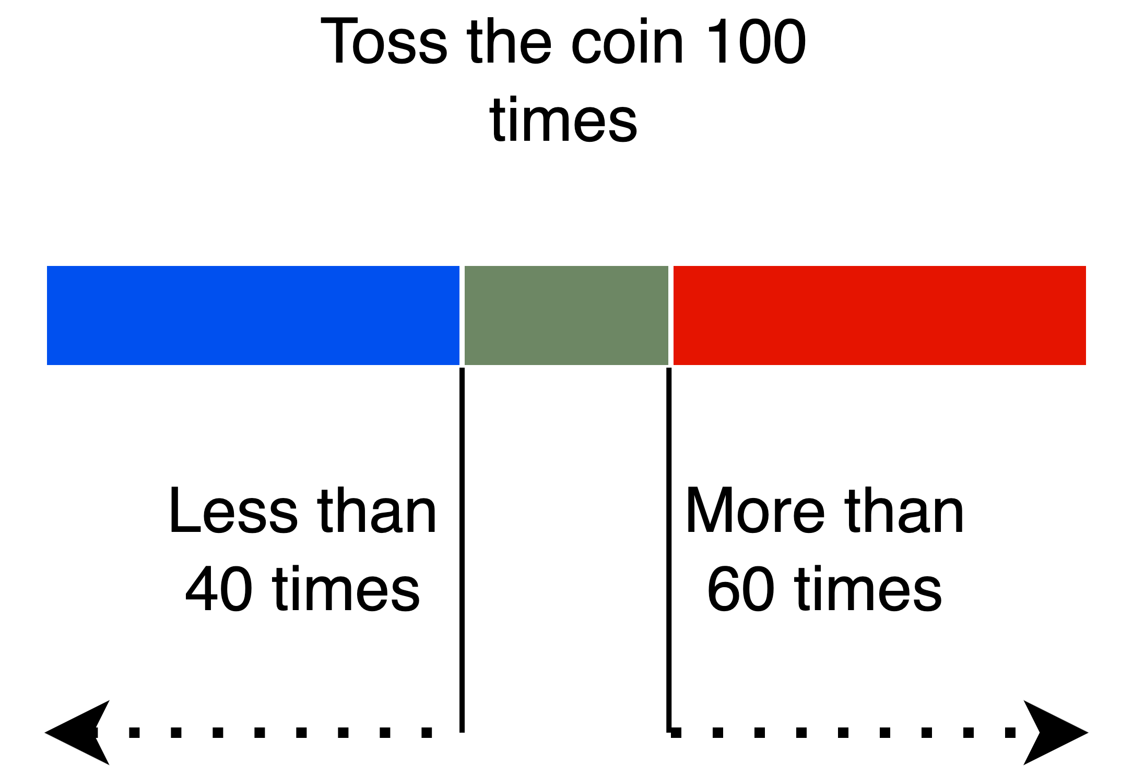
Coin tossing experiment
Now repeat this experiment
Toss a fair coin 100 times
How likely it is that the coin lands more than 60 times on head, or less than 40 times on head?

Slide 7
Coin tossing experiment
Now repeat this experiment
Toss a fair coin 100 times
How likely it is that the coin lands more than 60 times on head, or less than 40 times on head?
(3.52%)

Slide 8
Coin tossing experiment
What if we repeat the experiment again, and toss the coin 1000 times…
How likely it is that the coin lands more than 600 times on head, or less than 400 times on head?

Slide 9
Coin tossing experiment
What if we repeat the experiment again, and toss the coin 1000 times…
How likely it is that the coin lands more than 600 times on head, or less than 400 times on head?
Only 0.000000018%!
You may not encounter it even once in a million experiments!
The more you toss, the closer to 50% heads and 50% tails

Slide 10
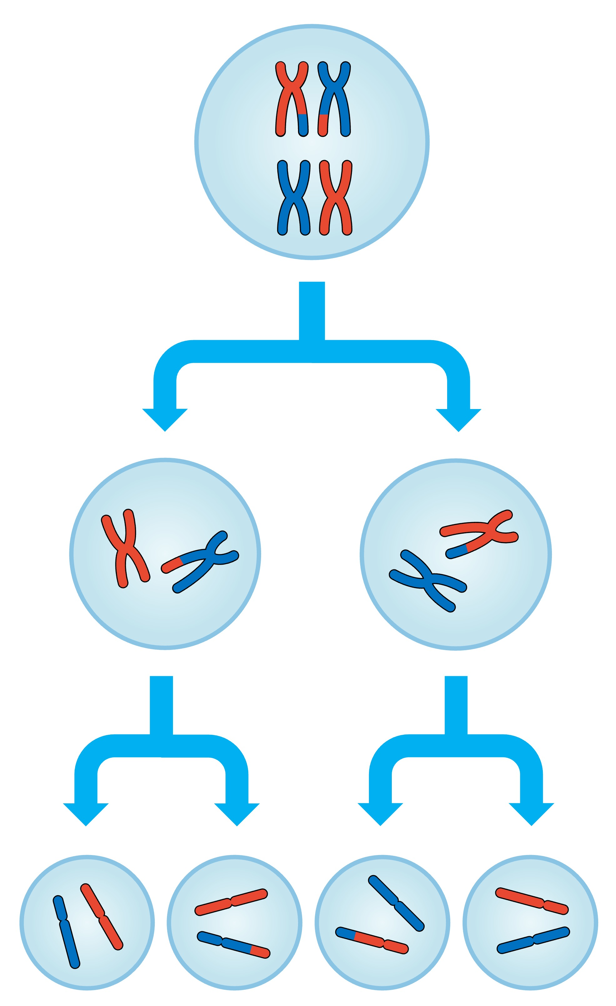
Where is the coin tossing in genetics?
Meiosis
- Type of cell division
Produces sex cells (sperm or egg)
Genetic materials are recombined

Slide 11
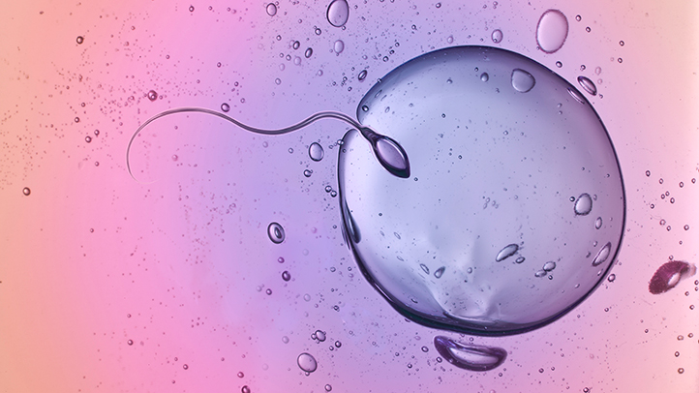
Where is the coin tossing in genetics?
Half of the genetic material from the father, half from the mother

Slide 12
More interesting than a coin tossing
Child Genome = 50% Maternal Genome + 50% Paternal Genome

Slide 13
More interesting than a coin tossing
Child Genome = 50% Maternal Genome + 50% Paternal Genome
What’s more?

Slide 14
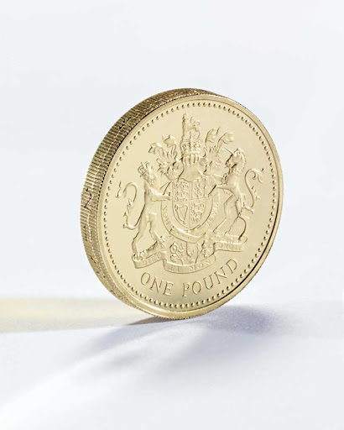
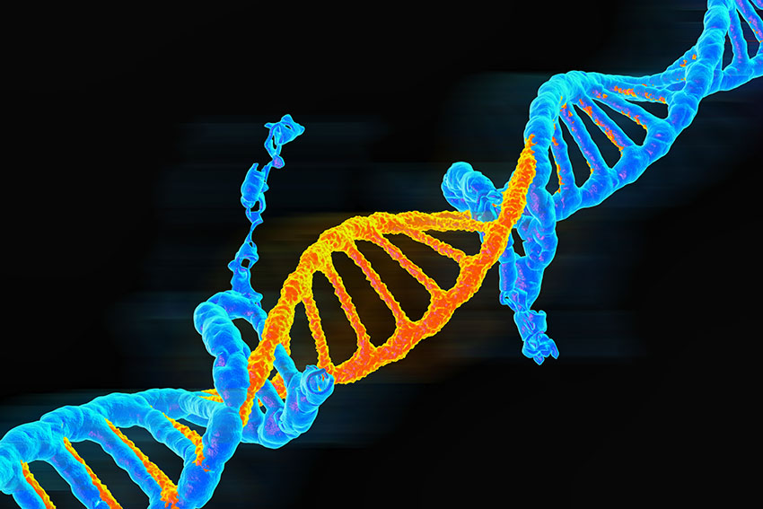
More interesting than a coin tossing
Coins can also stand!
Genetic Mutations!

Slide 15
More interesting than a coin tossing
Genetic Mutations
Extremely rare (1 in 100,000,000 base pairs per generation)
Most of them are bad
VERY few of them are neutral
VERY VERY few of them are good

Slide 16
More interesting than a coin tossing
Child Genome = ~50% Maternal Genome + ~50% Paternal Genome + Mutations

Slide 17
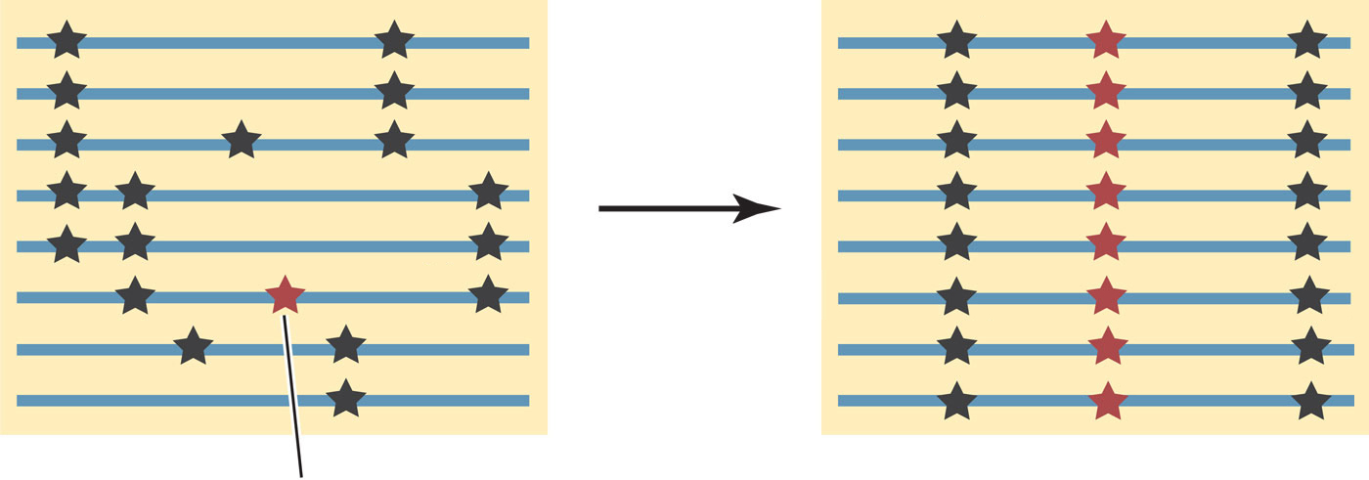
Good mutations tend to stay
A good mutation
A neutral mutation

Slide 18
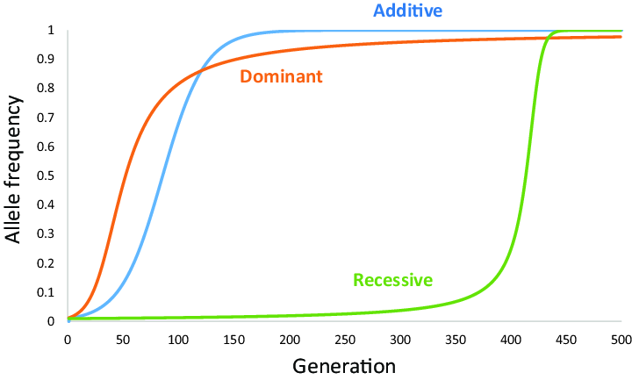
Good mutations tend to stay
% of people in the population with the mutation
(In frequency)
Natural Selection Sweep

Slide 19
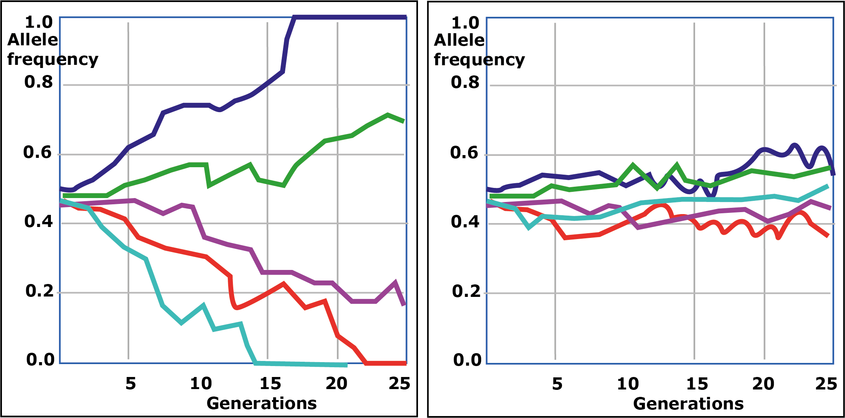
Neutral mutations can stay, too
Genetic Drifting
Human populations become different over time…

Slide 20
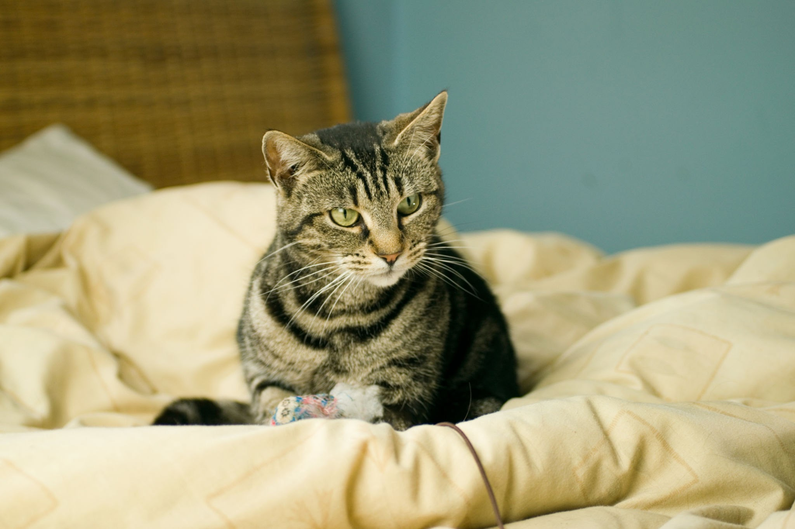
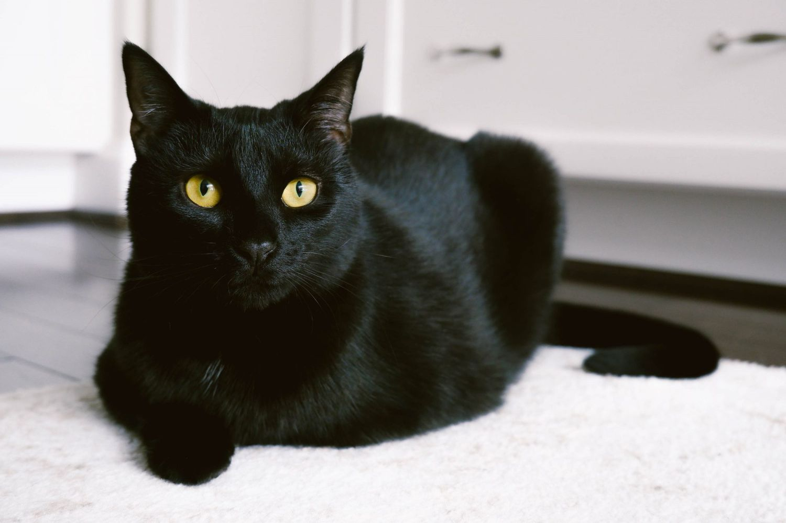
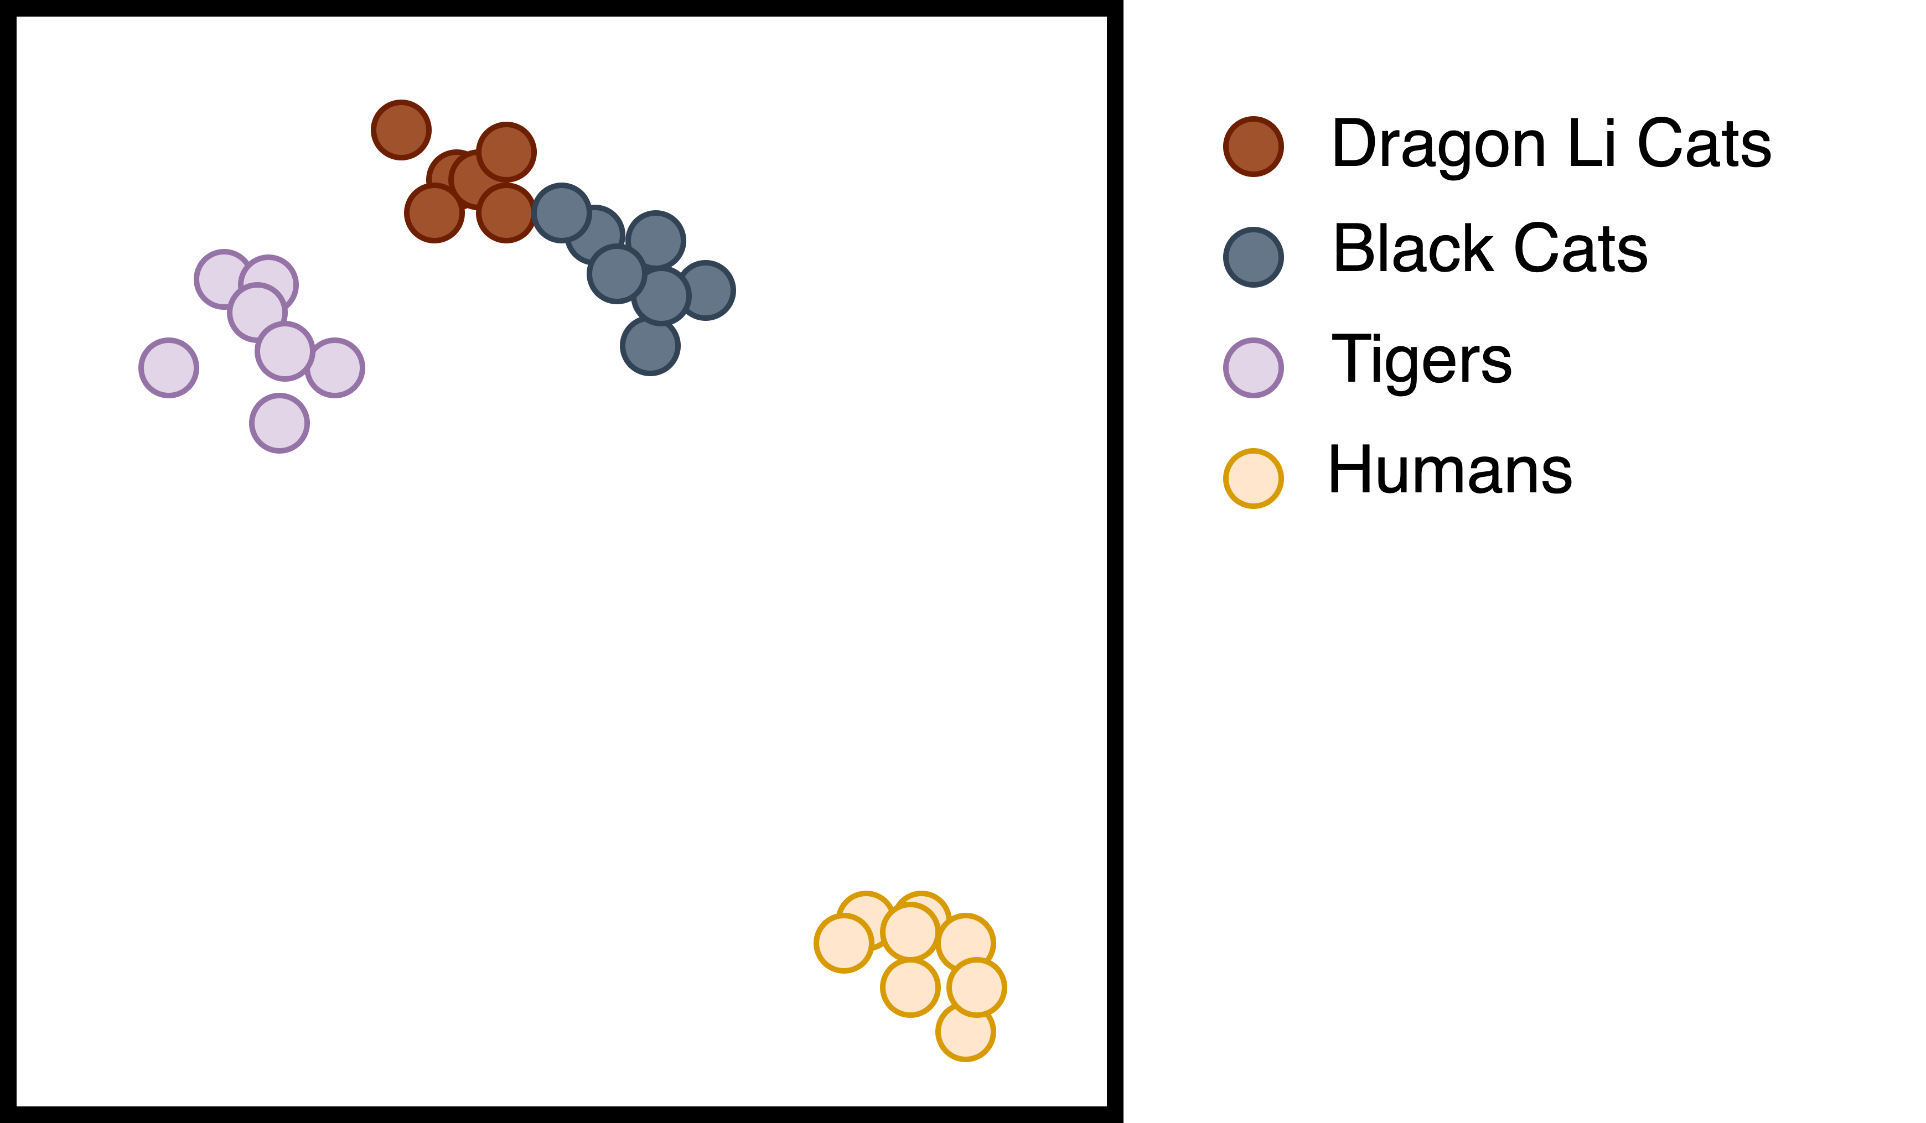
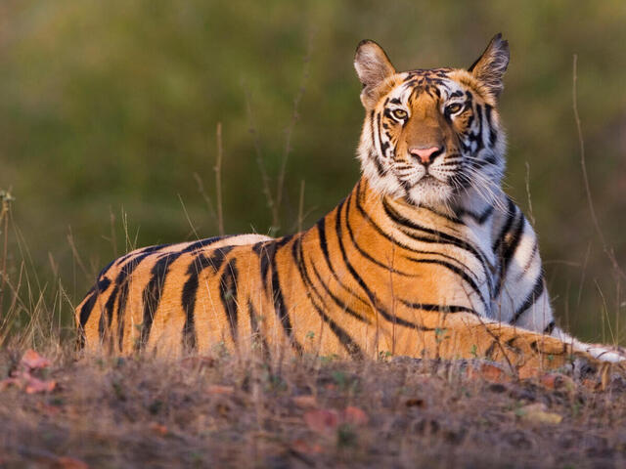

Similarities and differences

Slide 21
Similarities and differences
Cats are similar to each other
Tigers are like cats more than humans

Slide 22
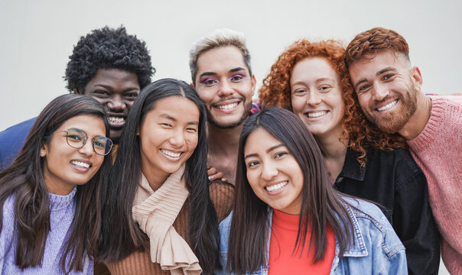
Human populations are genetically different
Humans differ by genetic ancestry
African
European
East Asian
South Asian
Hispanic/Latinx

Slide 23
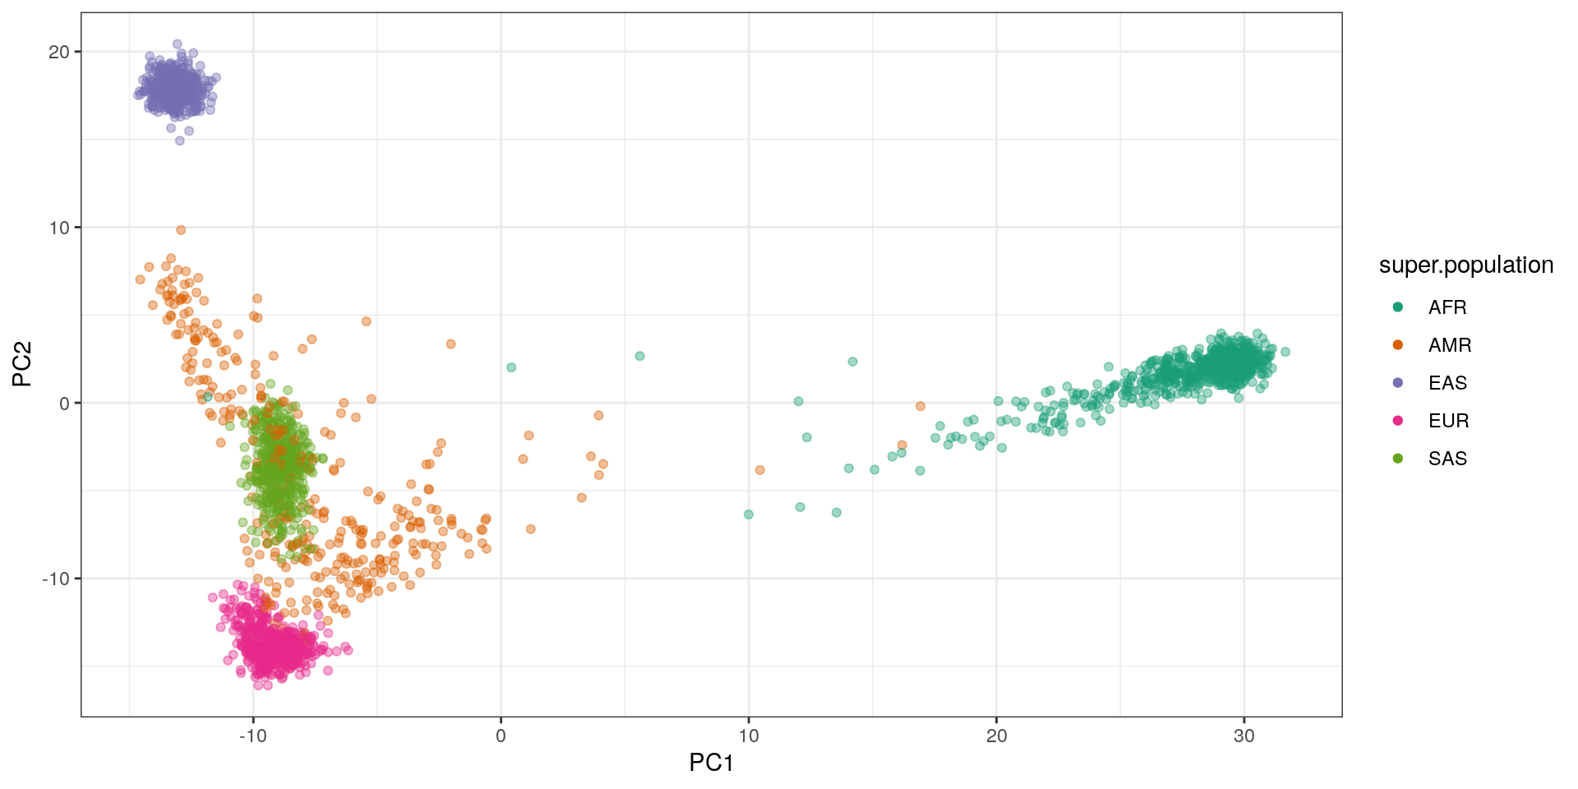
Human populations are genetically different

Slide 24
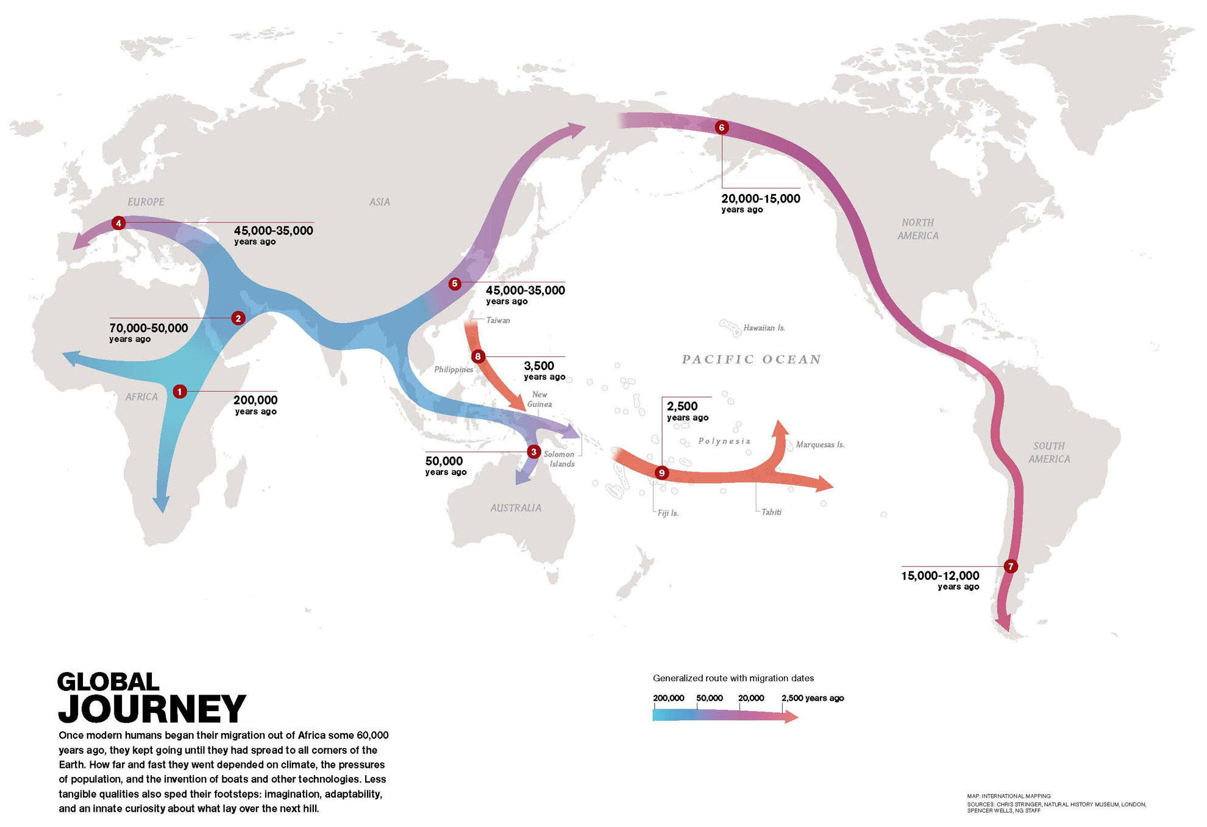
Human populations are genetically different

Slide 25
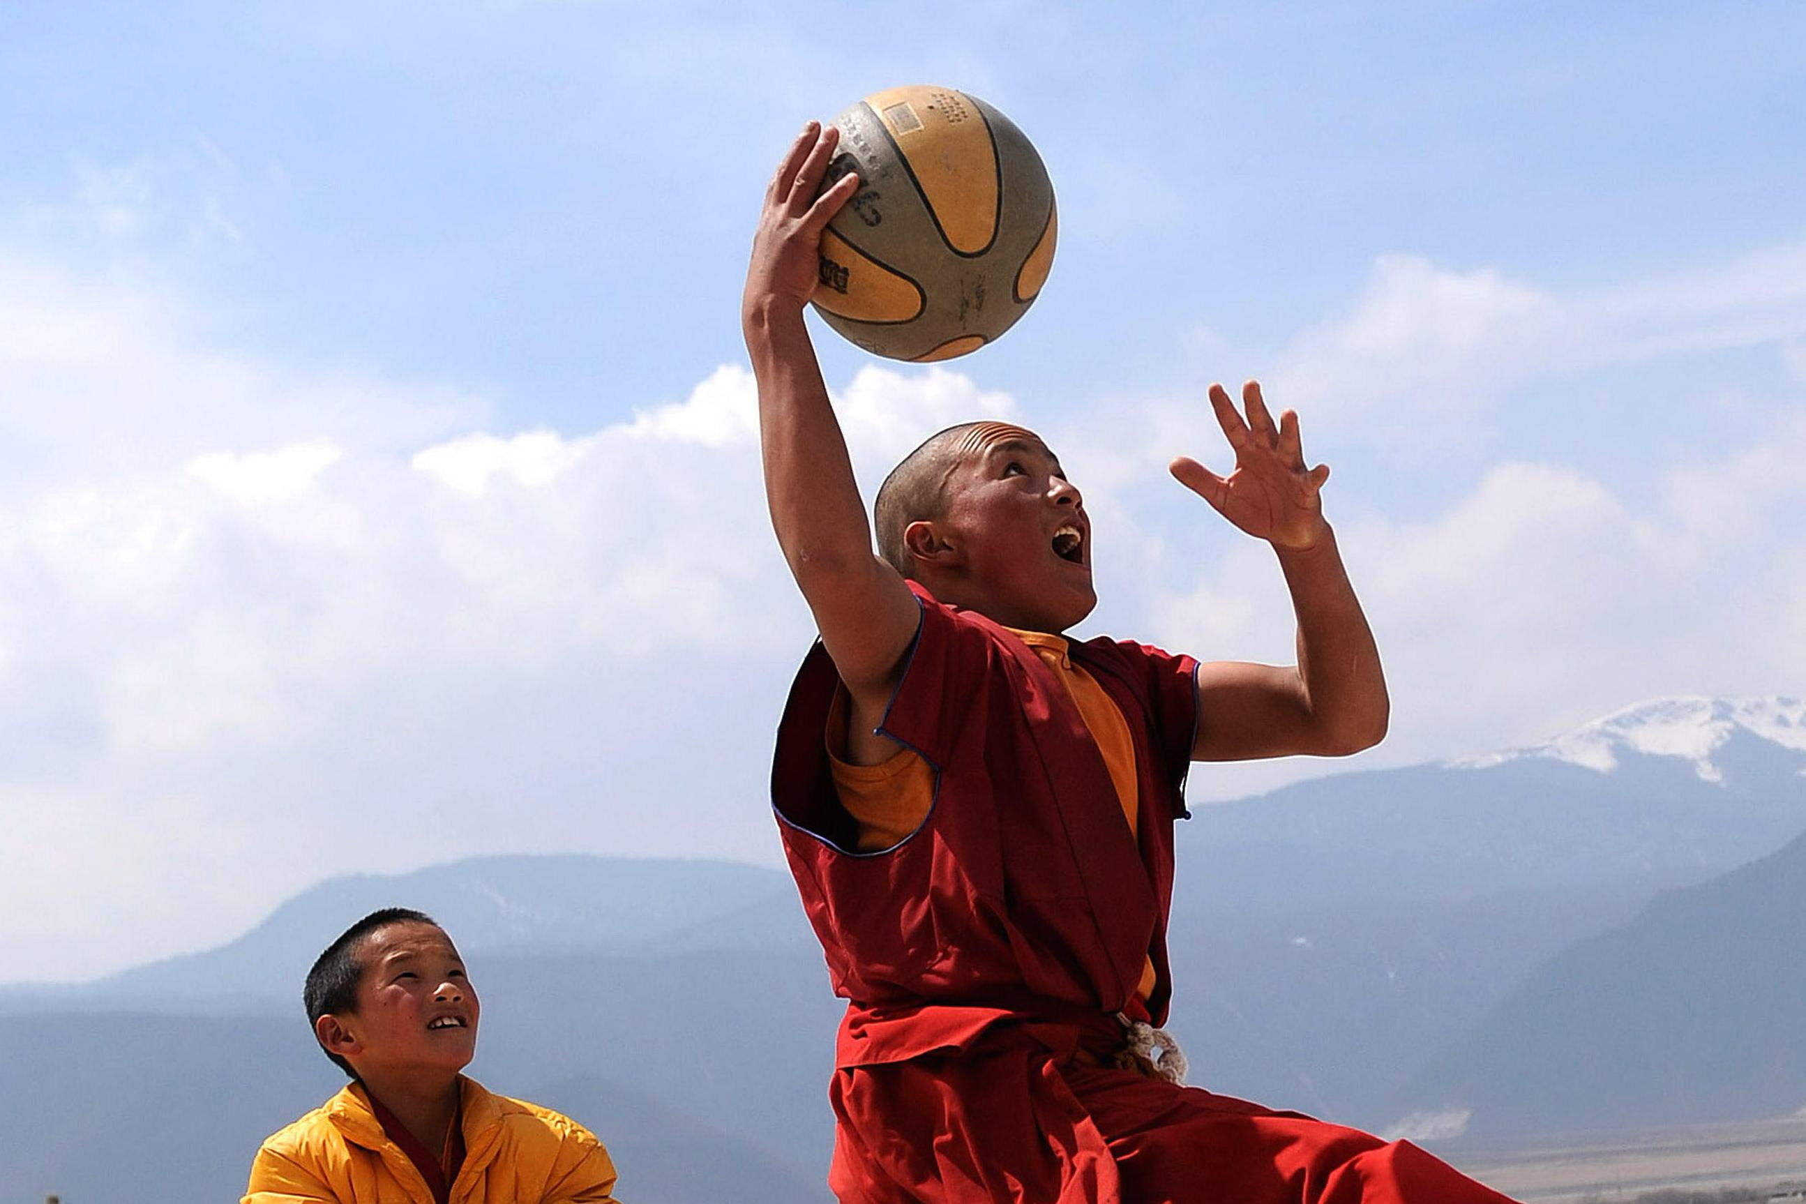
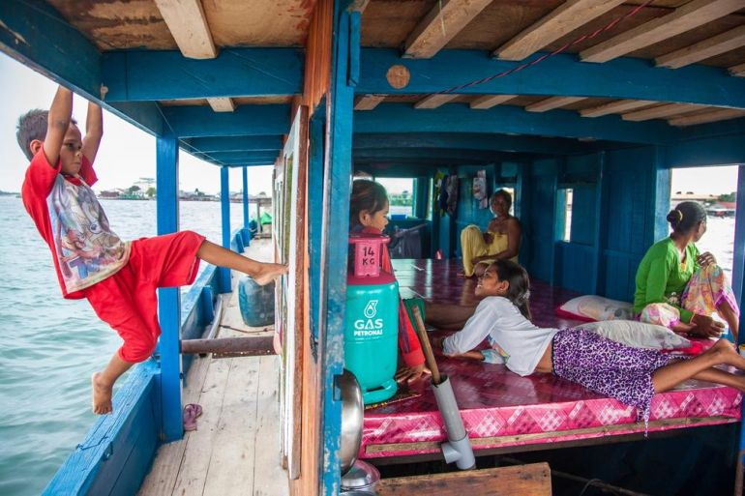
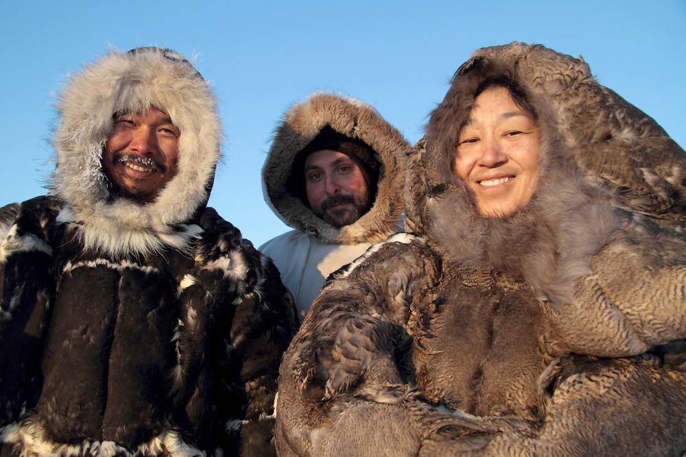
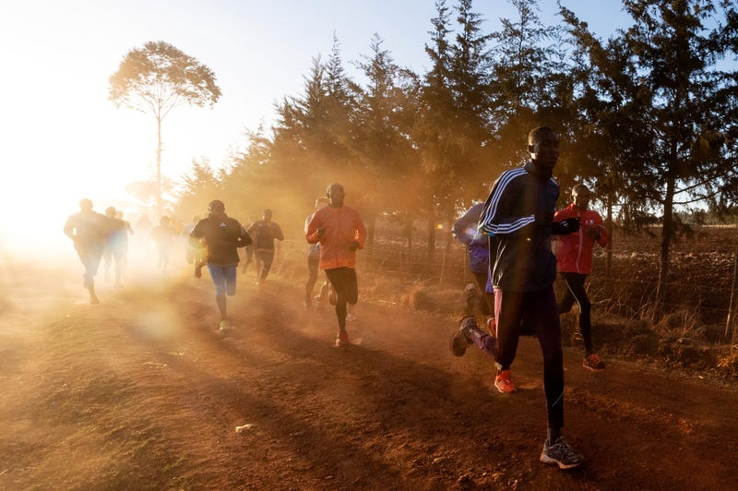
Humans can adapt to different environments
Tibetans (Altitude)
Tankas (Life on boat)
Inuits (Cold Climate)
Kalenjins (Running)

Slide 26
Summary and take-home messages
Coin flipping is fun, and it happens in nature as well
Our genome = ~50% paternal + ~50% maternal + mutations
Over generations, mutations build up to make populations different
Even so, humans share >98% of same genetics across ancestries
Natural evolutions help humans adapt to various environments
Become a population geneticist and uncover more mysteries!

